Slide 1
Building iOS Swift apps
5030-201720_MCS5993_M: 5030-Topics in Computer Science
5031-201720_MCS4993_M: 5031-Topics in MA/CS

Slide 2
Agenda
Leftovers
Core Data
Siri

Slide 3
Core Data
Notes:
The idea behind Core Data is that your data is organized and stored in the database through what are known as schemes. Schemes tell Core Data how your data is structured, and can be designed through a visual editor that’s part of Xcode.

Slide 4
Core Data
Notes:
When you create a project with Core Data already added to it, you should be able to see a file with the .xcdatamodel extension in your project.

Slide 5
Core Data
Notes:
In the visual editor of your scheme, press the Add Entity button at the bottom of the screen. This will create a new entity for you called Entity. From the data model inspector on the righthand side of Xcode, change this name from Entity to Car (Figure 4-3). The data model inspector allows you to change many aspects of your entities and their columns.

Slide 6
Core Data
Notes:
Under the Attributes section of the editor on top, press the little + button to create a new attribute, name this new attribute maker, and change its type to String. Also, on the data model inspector on the right side, uncheck the Optional box so that the maker of the car becomes a mandatory attribute

Slide 7
Notes:
Do the same thing that you did with the maker attribute and create another mandatory attribute of type String, called model

Slide 8
Notes:
Create another entity now, call it Person, and add two new mandatory attributes of type String called firstName and lastName

Slide 9
Notes:
In real life, a person can have multiple cars, although a car generally has one owner. This ownership status can be defined as a relationship between the two entities. Start by opening the Car entity. Under the Relationships section of the editor, press the + button and name the new relationship owner with the destination of Person (Figure 4-7). Make the relationship mandatory by unchecking the Optional checkbox in the data model editor. Leave the Inverse section empty for now.

Slide 10
Notes:
Open the Person entity and create a new optional relationship there. Name it cars and set the destination as the Car entity. Also set the Inverse field to the owner field of the Car entity. Then, under the data model editor, under the Relationship section, choose the Type checkbox and set the type of this relationship to “To Many”. Because this relationship is optional, a person does not necessarily have to have cars. Because the relationship is “To Many”, every person can have more than one car. On the other hand, because a car’s owner relationship is mandatory, each car always has to have an owner, and only one owner at a time.

Slide 11
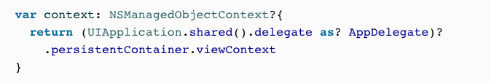
Core Data
Notes:
Your app delegate has your Core Data stack, so if you are in another class and would like to save your objects from there, you need to get a reference to your app delegate’s context using the persistentContainer.viewContext: NSManagedObjectContext property like so:

Slide 12
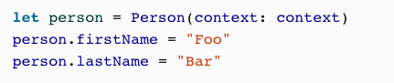
Core Data
Notes:
You can insert an object into your database using the (context:) initializer that is coded for you automatically by Xcode. Pass a managed object context to this initializer to create your object on that context. Let’s create an instance of our Person object now and set the person’s firstName and lastName mandatory properties. If you attempt to save your data into the database without setting a value for all the object’s mandatory properties, your app will crash by default.

Slide 13
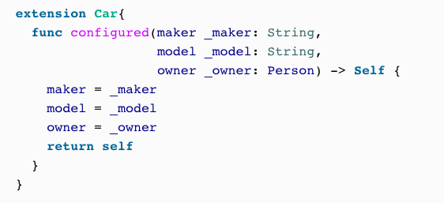
Core Data
Notes:
Now let’s extend our Car class so that we can configure an instance of it with a simple method instead of having to set all the properties one by one:

Slide 14
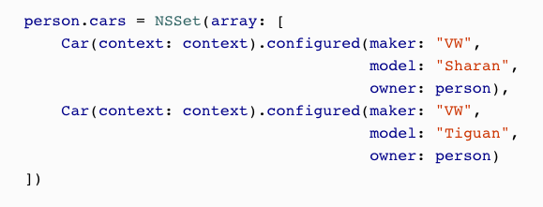
Core Data
Notes:
Then we can create two cars for the current person:

Slide 15
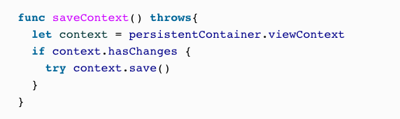
Core Data
Notes:
Once you are done with that, you can save your data into the database by calling your app delegate’s saveContext() function.
By default, the saveContext() function crashes your application if something goes wrong. I prefer not to do that and instead make this function throw an exception that I can catch later. So let’s change this function’s definition:

Slide 16
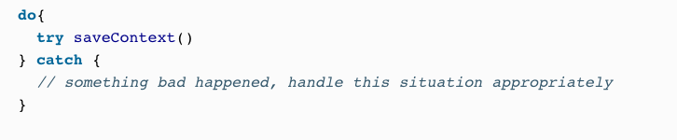
Core Data
Notes:
Once you are done with that, you can save your data into the database by calling your app delegate’s saveContext() function.
By default, the saveContext() function crashes your application if something goes wrong. I prefer not to do that and instead make this function throw an exception that I can catch later. So let’s change this function’s definition:

Slide 17
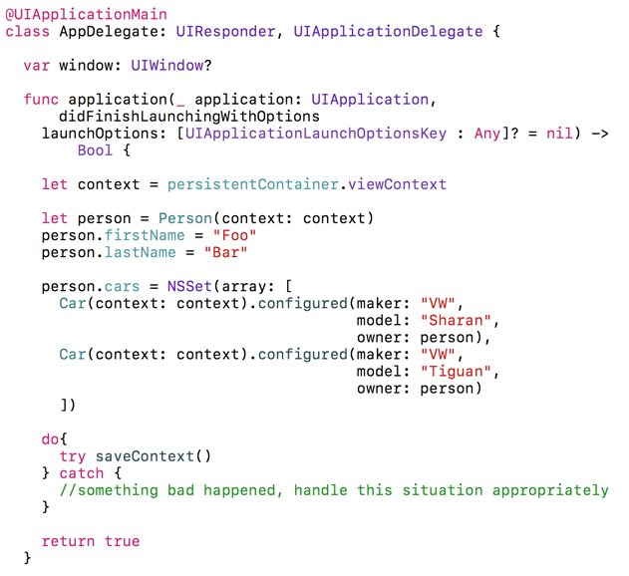
Core Data
Notes:
Open writing data to the database app and run
OK now we’ve wrote the data, we’re going to need to read it nw

Slide 18
Core Data
Call fetchRequest()
Set fetchLimit, relationshipKeyPathsForPrefecting
propertiesToFetch
Notes:
Call the fetchRequest() class method of your managed object (such as the Car object) to get an object of type NSFetchRequest<T>, where T is your class name such as Car.
Once the fetch request is returned to you, configure it using some of the properties described here:fetchLimit: IntThe maximum number of instances of the current class to fetch as the result of the search.relationshipKeyPathsForPrefetching: [String]?An array of strings that denote the relationships of the current object whose results must also be fetched. For instance, our Person object has an optional one-to-many cars relationship. So if you want to find what cars this person owns (if any), as well as the person herself, insert the name of the cars relationship into this array.propertiesToFetch: [AnyObject]?This is an array of the attribute names of the managed object whose values you want to pre-fetch. For instance, the firstName and the lastName properties of the Person object can be passed to this array to ensure that their values are pre-fetched for you.
Once your fetch request is ready, execute it on your managed object context using its fetch(_:) function.

Slide 19
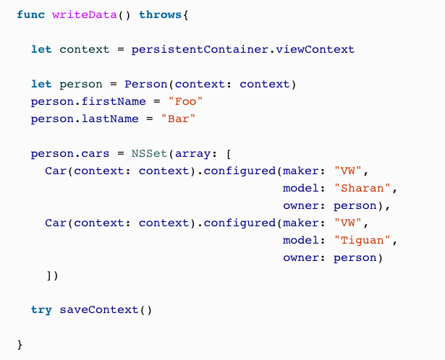
Core Data
Notes:
Let’s put the code that writes these instances to the database, into a function so that we can easily call it from another place:

Slide 20
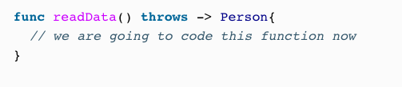
Core Data
Notes:
And then start by writing a function that can read only one Person object back from the database if one exists:

Slide 21
Core Data
Notes:
In this function, assuming it is being written in your app delegate’s class where you have access to your managed object context, construct a fetch request on your Person object like so:

Slide 22
Core Data
Notes:
Tell Core Data that you want to pre-fetch the cars relationship of the Person entity and that you want to fetch only one instance of the Person object:

Slide 23
Core Data
Notes:
Then call the fetch(_:) function of your managed object context to retrieve the results:

Slide 24
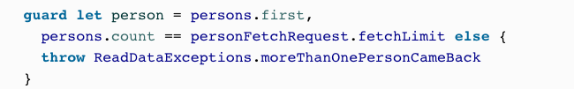
Core Data
Notes:
We are also going to check that we fetched only one Person instance from the database. Otherwise, we will throw a new exception, since our function is marked with throws:

Slide 25
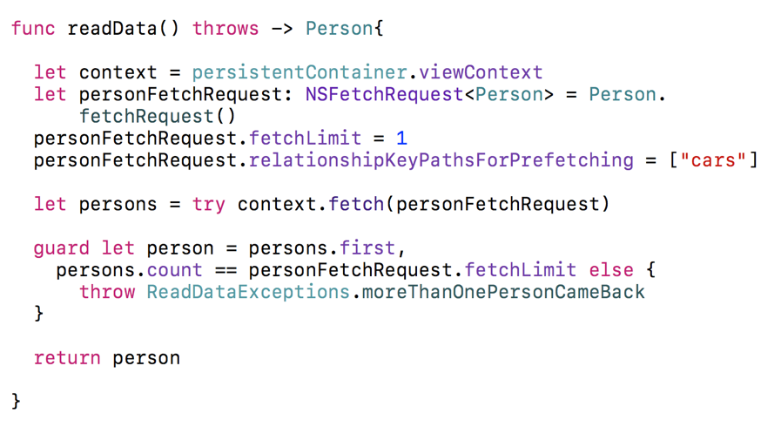
Core Data
Notes:
Now that we have both the writeData() and the readData() functions

Slide 26
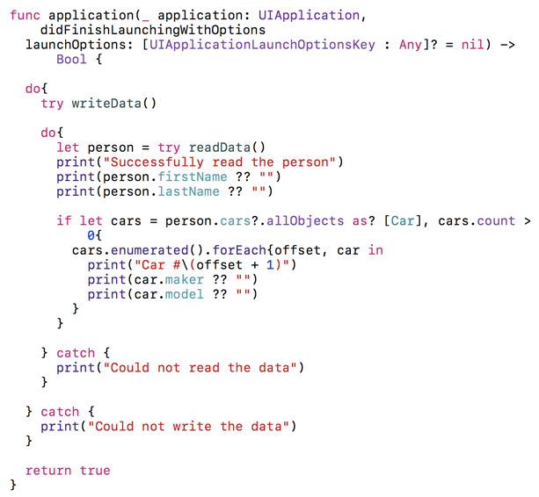
Core Data

Slide 27
Core Data
Successfully read the person Optional("Foo") Optional("Bar") Car #1 Optional("VW") Optional("Tiguan") Car #2 Optional("VW") Optional("Sharan")

Slide 28
Siri

Slide 29
Siri

Slide 30
Siri

Slide 31
Siri
Notes:
Open the info.plist file of your app. Create a new key/value pair in it, setting the key to NSSiriUsageDescription. For the value, enter a brief text message that tells the user why you are attempting to integrate your app with Siri

Slide 32
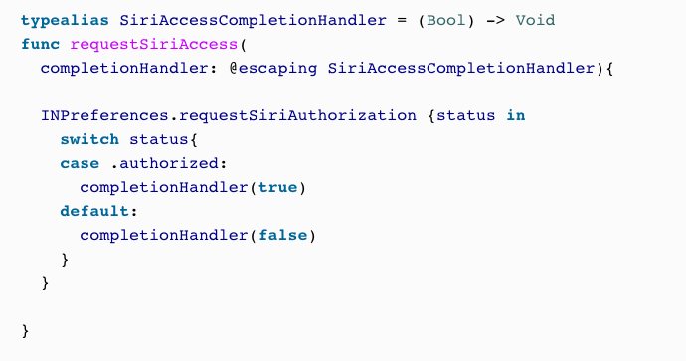
Siri
Notes:
Import the Intents framework into your source code and then call the
requestSiriAuthorization(_:) class method of the INPreferences class to request access to Siri:

Slide 33
Siri
Notes:
Go to the Files menu, select New and then Target, and then from the screen, under the Application Extension section, choose Intents Extension (Figure 2-5) and click Next.

Slide 34
Siri
Notes:
Give the Intents extension a name “IntentsExtension” (Figure 2-6), then press Finish to save and add it to the project. An Intents extension is your delegate through to Siri’s capabilities, and this extension is your window to your users, through Siri!

Slide 35
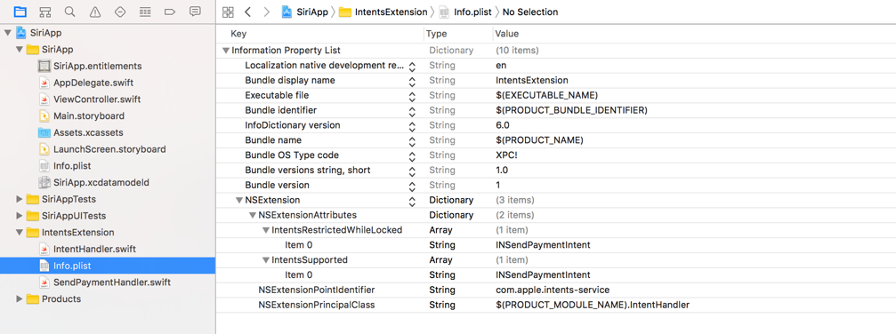
Siri
Notes:
In your newly created Intents extension’s info.plist file, go to the NSExtension key, expand it down to NSExtensionAttributes, and further expand that down to IntentsSupported and IntentsRestrictedWhileLocked. Under these two arrays of strings, you can list the name of the classes (such as INSendPaymentIntent) that your extension supports. Whatever you list under the IntentsSupported key will be a supported intent by your app, and whatever you list under IntentsRestrictedWhileLocked requires the user’s device to be locked before that intent can be resolved. You can use this latter functionality to create more secure intents, such as when you want the user to be able to send money to a friend or a family member.
The INSendPaymentIntent that we want to use requires the device to be locked for the sake of security, so you have to list it under IntentsSupported to indicate that your app supports this intent. You also have to list it under IntentsRestrictedWhileLocked to tell iOS that this intent requires the user’s device to be locked before the user can use it.

Slide 36
Siri
Notes:
You want to handle a specific Siri intent and you want to be able to handle all its related delegate messages to and from Siri.

Slide 37
Siri
Notes:
In the Subclass field, enter the class name of the intent that you wish to handle, such as INSendPaymentIntent. Then enter the name of the class that you wish to create in your own project, such as SendPaymentHandler (Figure 2-8). Proceed to the next screen to add it to your Intents extension target and save the file on disk.

Slide 38
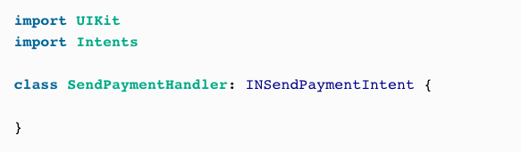
Siri
Notes:
The newly created file will be opened for you. Xcode will complain that this file isn’t compilable, because Xcode doesn’t import the Intents framework by default, so help Xcode by importing it:

Slide 39
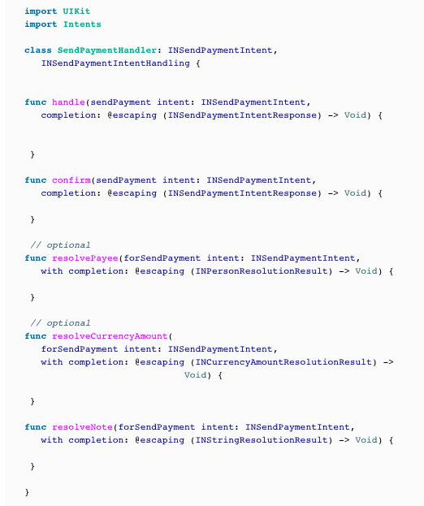
Siri
Notes:
Every intent handler has to conform to a protocol named XHandling, where X is the name of the intent class. If your intent handler is called INSendPaymentIntent, for instance, your intent handler class must conform to the INSendPaymentIntentHandling protocol:

Slide 40
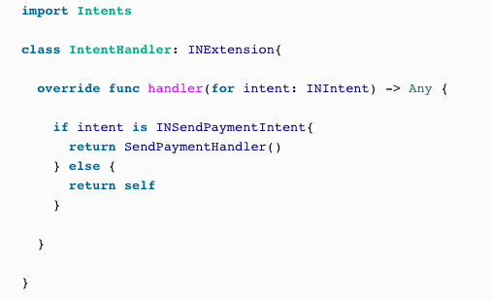
Siri
Notes:
Open the IntentHandler.swift file that was already created for you when you created your Intents extension target. In the handle(for:) method of INExtension, return an instance of your newly created SendPaymentHandler class whenever an intent of type INSendPaymentIntent is about to be resolved:

Slide 41
Siri
Notes:
A dialog will appear asking you the app to which you want to attach your intent. In this dialog, choose Siri (Figure 2-9) and then press the Run button.

Slide 42
Siri
Notes:
This will then run Siri with your extension attached to it. Once Siri is up and running, say “Send 15 dollars to Anthony.” This will cause Siri to ask you to confirm that you want to make this payment using the app that we have been working on (Figure 2-10).

Slide 43
Siri
Notes:
If this is the first time you are giving this permission, Siri will ask to access your app’s data with a dialog similar to Figure 2-11.

Slide 44
Siri
Notes:
Press the Siri Settings button that is provided to you (Figure 2-12) and allow access.
Now if you go back to Siri and repeat this request, your extension will be run but will time out after a while, because we didn’t really implement any of the required callbacks in our shiny new SendPaymentHandler class. You will learn how to do that in the upcoming recipes.

Slide 45
Siri
The given payee resolves unambiguously to a payee that your app recognizes. This is a success.
The given payee doesn’t resolve to any payees that your app can recognize. This is a failure.
The given payee resolves to more than one recognized payee in your app. This is an ambiguity.
Notes:
Your intent delegate finds multiple entities that match what Siri asked you to operate on. For example, multiple people might match the name to which the user wants to send a payment, multiple activities might match the one the user asked to be paused, and so on.
Use the ambiguity APIs that are provided in every XHandling protocol, where X is the intent that you are working with. If you are working with sending payments from within your intents, you have to create a subclass of INSendPaymentIntent and then implement the delegate methods in INSendPaymentIntentHandling. One of these methods is resolvePayee(forSendPayment:with:), which gives you the payee who Siri believes to be the user specified along with a completion handler that you can call. The completion handler contains a value of type INPersonResolutionResult that specifies whether:

Slide 46
Siri
Send 15 dollars to Anthony
Anthony Foo
Anthony Bar
Notes:
Let’s examine a case where the user says, “Send 15 dollars to Anthony” but has two contacts named Anthony:

Slide 47
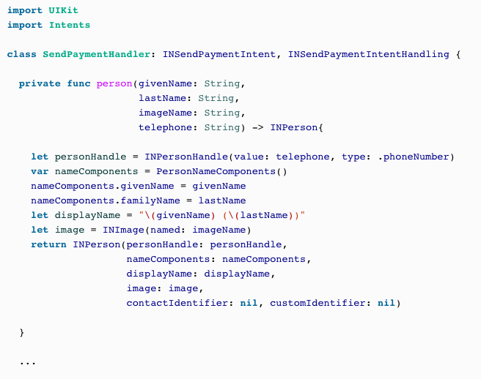
Siri
Notes:
People that the user can pay should be of type INPerson, so let’s define these two people in our app by creating a function that can create an instance of this class, accepting a first name, last name, and other pertinent information, including the telephone number (which is necessary for payment processing purposes):

Slide 48
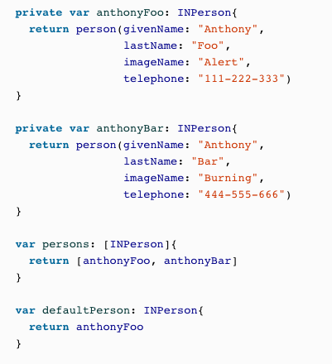
Siri
Notes:
We can then proceed to create these two person instances and designate one of them as the default person to whom all payments are made:

Slide 49
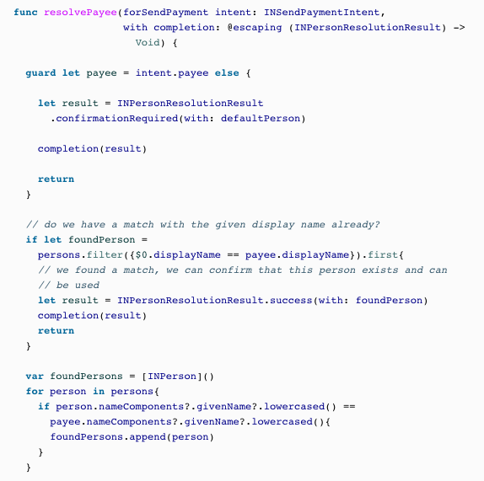
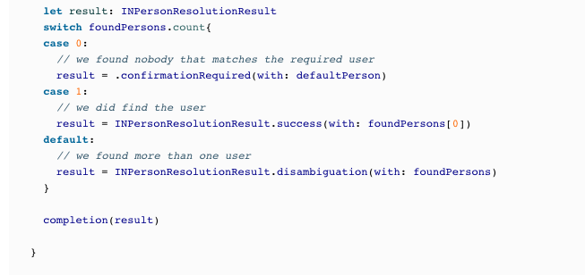
Siri
Notes:
Then we need to start implementing the resolvePayee(forSendPayment:with:) function of our payment delegate. In here, we first look at the payee that Siri has interpreted as the intended recipient of the payment, and then attempt to find this payee in the list of people that our app supports sending money to. If we find such a person, we proceed. If we find more than one person with the given name, we ask Siri to resolve the problem. Siri does this by running a procedure called a disambiguation. Siri shows the user a dialog containing all the possible payees, prompts the user to choose the intended recipient of the payment, and then calls a completion handler to carry out the operation.
Finally, if we don’t find any person with the given name, we provide the default person that we have defined just a few seconds ago, and ask the user to confirm whether she wants to send the payment to this user:

Slide 50
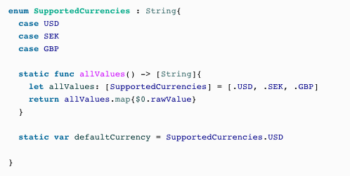
Siri
Notes:
So let’s define the list of currencies that we support:

Slide 51
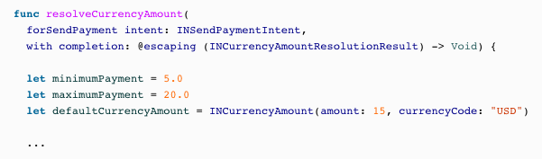
Siri
Notes:
And then define our minimum and maximum payment values:

Slide 52
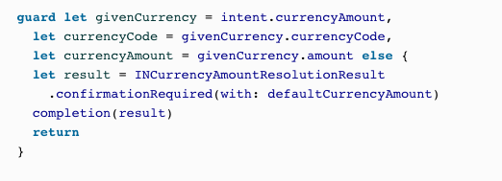
Siri
Notes:
When the user makes a request to send money, we can then check whether she has specified a valid currency value and amount. If not, we will provide our default currency and amount and ask the user to confirm them:

Slide 53
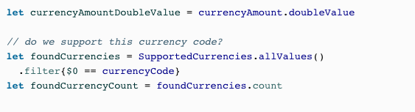
Siri
Notes:
We then find the given currency code in the array of our supported currencies:

Slide 54
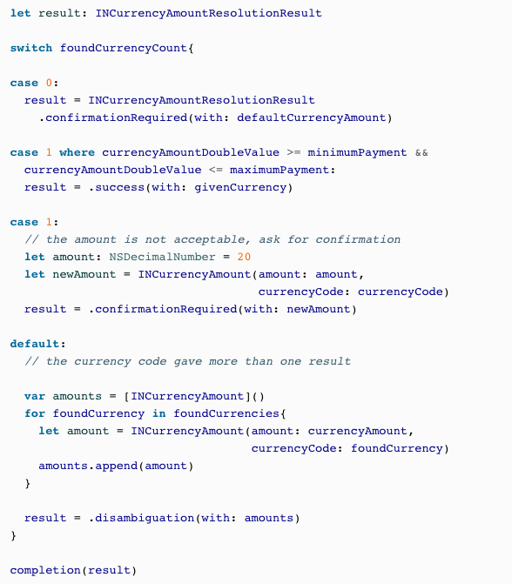
Siri
Notes:
Depending on whether we could find this currency code, we decide how to call the completion handler:

Slide 55
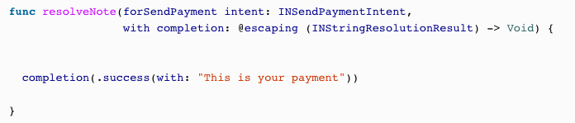
Siri
Notes:
You also have to handle the resolveNote(forSendPayment:with) method of INSendPaymentIntentHandling. This lets the user who is making the payment attach a note of type String to be sent alongside the payment to the recipient. Here you also have the chance to either accept that note or resolve any ambiguity in it. In this example, we simply override any given note with a constant string for the sake of simplicity, but you get the idea!

Slide 56
Siri
Notes:
After the user confirms that she would like to use SiriApp, Siri will ask the user to clarify the intended recipient, since there are two instances of Anthony in our app (Figure 2-14).
Then we will resolve the payment amount. Because $15 is in our acceptable range, Siri will proceed to call our delegate’s confirm(sendPayment:completion:) method, which we have not yet implemented.

Slide 57
Siri
Notes:
So now if the user asks Siri to “Send 15 dollars to Anthony,” she will first see the dialog shown in Figure 2-13, asking for confirmation of whether she would like to use SiriApp.

Slide 58
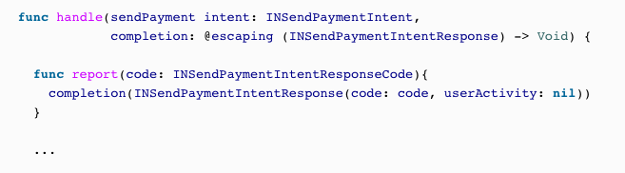
Siri
Notes:
You have resolved all ambiguities regarding a Siri intent that you are handling and have also confirmed that the intent can in fact go through successfully. Now you have to actually see the process through and handle the intent.
Implement the handle(_:completion:) method of your XHandling protocol, where X is the name of the intent you are handling, such as INSendPaymentIntentHandling.
Let’s now have a look at an example based on what we learned in Recipe 2.4. We will have a local function that can report our codes to the completion handler:

Slide 59
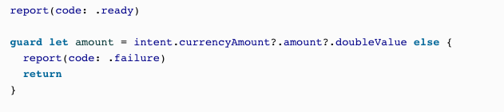
Siri
Notes:
Then we extract the amount that has to be transferred and ensure that it is present:

Slide 60
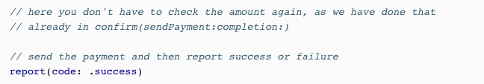
Siri
Notes:
Last but not least, we will make the payment and then report either .success or .failure to the user:

Slide 61
Agenda Tuesday
More Leftovers
Oauth
Apple Watch

